Slide 1
The Death of the
Enterprise Data Warehouse
o
r
EDW
in memory
f
Paul Groom
Notes:
Language – one word changes and the whole meaning shifts
one word like Hadoop is creating seismic shifts in the world of data and its use
Core themes:
History – cycle of discover-construct-discover-construct
Humans building
EDW has had its time but will represent learning and museum for future
Kognitio is new bridge between business need and the information stores of the EDW and Hadoop

Slide 2
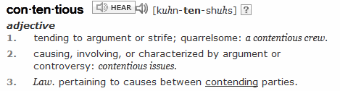
contentious
…early in stating change
Notes:
Such a contentious title – or is it?
Slanderous to IT, but is it contentious to the business users?
Contentious is not necessarily wrong, just early/bold in forecasting change
bold in stating the inevitable!

Slide 3
Parallels in History
Even the indomitable succumb
Notes:
History is all about change, leasons repeat, remembered/forgotten
History is written by the victor with the victors perspective
How the once thought immutable succumb

Slide 4

Pioneer
Explorers
Adventurers
s
rs
urers
Notes:
Discovery by man; discovery by the world of IT
Raw, rough-and-ready, make up it up as you go along
Keep moving, keep surviving, keep inovating
Built little – a few milestones and huts along the way
Early Spreadsheets and desktop databases, pre-relational, early decision support

Slide 5
Settlers
Builders
Engineers
Establish
Consolidate
Define
Notes:
Man loves to build – consolidate on the backs of the explorers – hold that ground, build up and out
Same in IT – The accent of the Relational DB holding more and more data

Slide 6
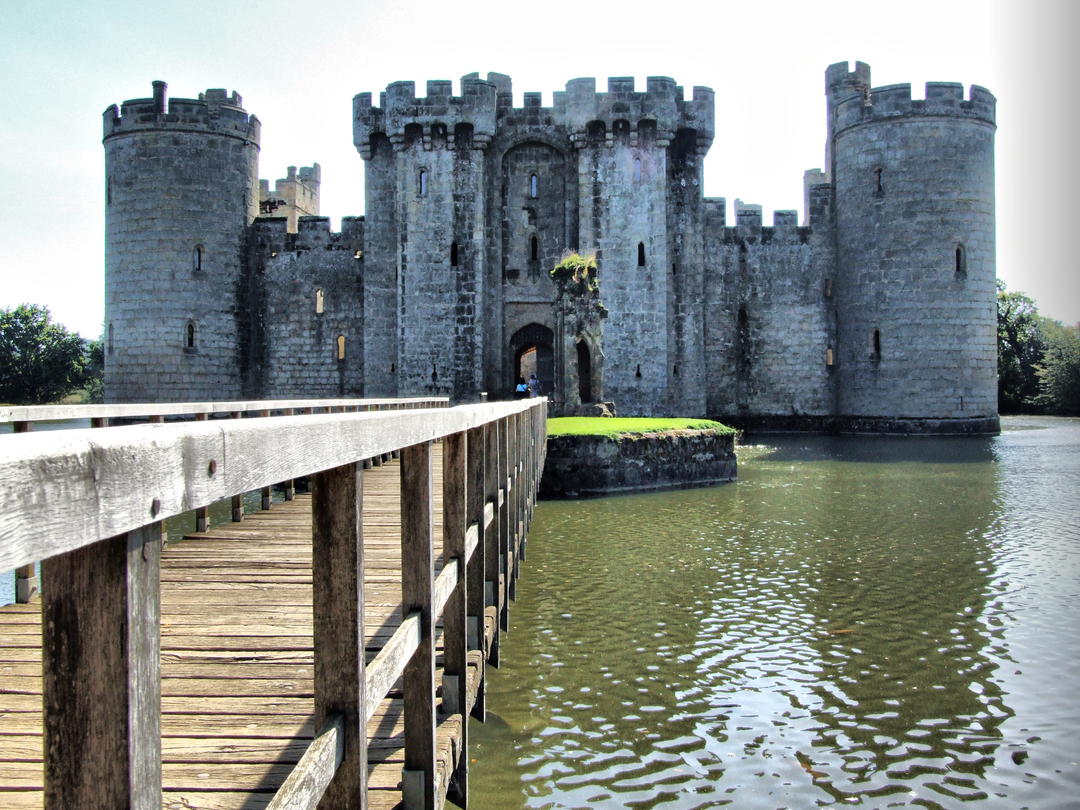
Notes:
Epitome of construction is Castle in History and EDW in modern IT
(Bodiam Castle – from Eric Star Picture)
Consolidate power, protect, stand the test of time, some where safe in difficult times
The DW built to protect the corporate knowledge
Law and discipline – structure, trust, safe haven - Control

Slide 7
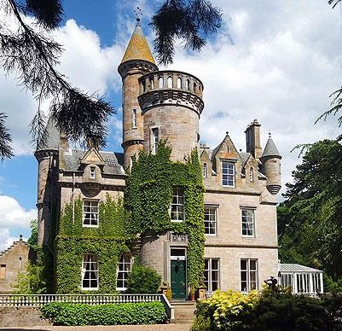
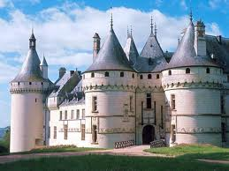

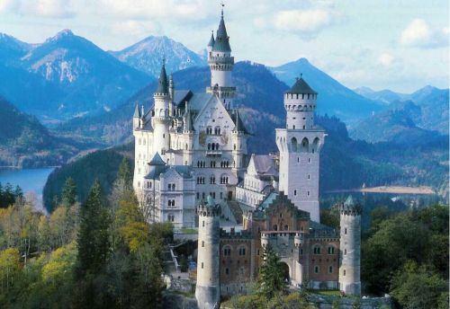
Lots of EDW variety
Notes:
Small Scotish castle
French style
Himeji castle - matsumoto – Japan
Neuschwanstein castle – fairy tale - mad Ludwig inveterate castle builder

Slide 8

…the status quo
Notes:
EDW provided information backbone for business for many many years
Many years of growth, absorbing and digesting data
Provided structure, quality – goal of single version of the truth
Business intelligence build out, lots of reporting, more analytics

Slide 9
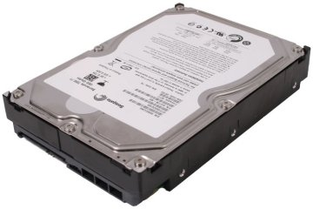
EDW = Store + Analyze
but…
Notes:
Classic database and data warehouse says you store and analyse in same platform – data workhorse
Plus symbol is issue – standard architectures were disk great for storage but low on CPU
Has to ingest – ETL help to some degree, has to protect, keep consistent, then provide access and analytics
Standard relational gave away to appliances e.g. Teradata, Netezza
But all are based on spinning disk and moving data back and fore – read/write/swap

Slide 10
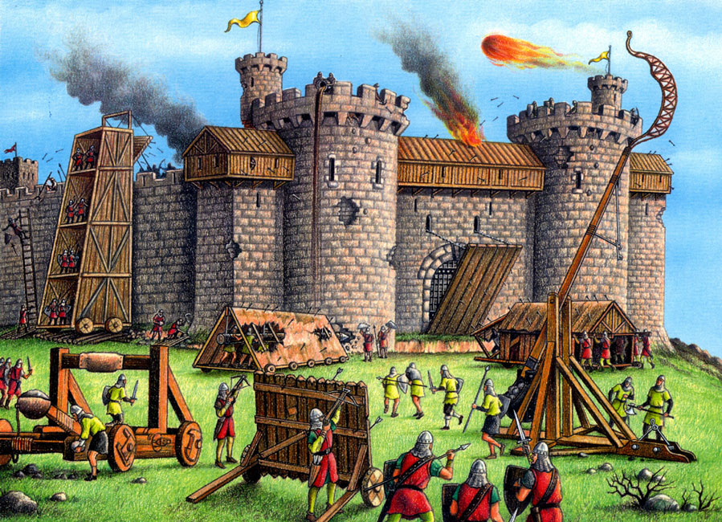
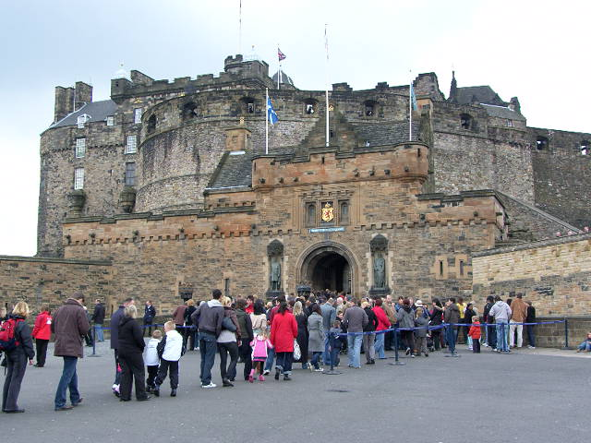
analytical workload
Notes:
DW starts to overload, starts to be selective,
Who’s allowed in, what are they allowed to do and access – like visitors to modern castle
- but not necessarily with nice guidebook
Ultimately its queues and delays cannot cope - users initially patiently, later impatient
business wants more and faster
IT see’s pressure from a different perspective – trouble and pain – Main inhibitor is complexity and cost

Slide 11

EDW says no or not now!
Notes:
How often these days does DBA or DW manager say no or not now?
Throttling, limiting, restricting data and processes
Castle serves to keep undesirables out – pull the drawbridge up!
Selective with business users – business case
But the wold is still changing, data is still booming, events happening as this slide presented

Slide 12
Fear of new data…
…cost of yet more data
Notes:
Biggest inhibitor is when EDW says no or not now for new data
Business and IT domain is evolving fast so new data is a fact of life
Rapid integration, assimilation and accomodation of data is vital

Slide 13
Why?
Issues around:
Capacity
Cost
Flexibility
Innovation
Notes:
What changed – EDW rationalised and consolidated the details
Too many details now, too little time – conflict of data load aginst data use
Yes cost mentioned a second time – reiterate that economic downturn changed attitudes to ever larger EDW!
Can’t keep buying more disks and associated expensive software
But the new world brought a tidal wave of details
Cost of appliances/software

Slide 14


Infrastructure
Notes:
More change – in-house big systems now under threat from cloud services – yes even the EDW
- remember not all EDW are petabyte scale, majority are sub 5TB
Its not just about the big enterprises, regular business wanted benefits of EDW or just plain DW
Building and ownership – the castle is the ultimate infrastructure
But the world has expanded and built around them
castle is point of control – data is now pervasive and well spread
Big vendor

Slide 15
Disappointment leads to
D
i
s
a
g
g
r
e
g
a
t
i
o
n
Notes:
Business users frustrated, disaggregation, start doing their own thing again – Explorers/pioneers/adventurers
New tools quickly step in e.g Qliktech – in same category as Excel liked by users hated by IT
Users wanted EDW to work –wanted single version truth, up to date, any data
BUT…Performance for users slowed or work was restricted
desktop BI mashup tools
data discovery tools
no relational data!

Slide 16
DATA
data
Notes:
And at the same time with have the early wave of BIG DATA.
Hmmm - Big data – was there ever small data? All Relative to time and technology
And appetite of business

Slide 17
necessity
or
serendipity?
Notes:
Chicken or egg
Something new came along – the elephant with a cute name
Did big data create need for Hadoop
or did hadoop allow untapped data (dark data) to be brought into regular use
Innovation
Driven by cost savings – avoid heavy software costs built up by EDW vendors
All predicated on disk – which had got steadily larger capacity and cheaper
Incubator well away from the influence of the EDW

Slide 18
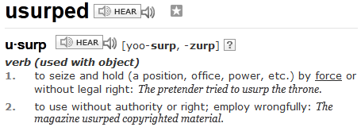

Notes:
The EDW has been usurped
Programmers like freedom of use – can play and experiment
EDW - Too damn difficult, too damn costly, Loss of agility
EDW loses position of strength as world changes around it
Fear of new data, fear of new users, fear of increasing cost

Slide 19

Wild West
Data
Notes:
Dangerous but exciting times
Loss of control and governance – too much going on around the EDW
Business and IT in gun fight – Wild West

Slide 20



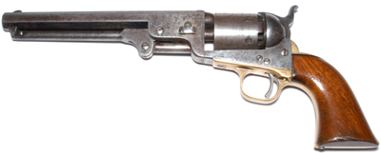
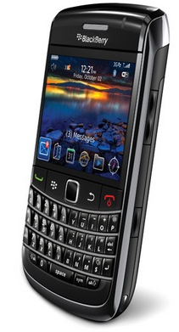


Notes:
Six gun, disruptive in wild west days
now its the pervasive mobile device and the social networks
how many people in audience checking face book, stock moves, email, how many mobile device in close reach

Slide 21
How many events just occurred, were captured and now require analysis?
EDW says No!
Hadoop says Yes!
Notes:
Reach for own phone and fiddle with – talk about distracted users, attention deficit
Being in contact
Events events events – business want to break into that activity and monitor and learn and promote

Slide 22
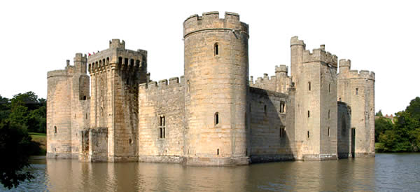
Fear
Kimball
Inmon
Notes:
Halloween so close, not that fear, fear of loss of control, loss of discipline
Most Hadoop programmers in Kindergarten when Bill and Ralf were showing the way
Ghosts of Inmon and Kimble – where is the new data discipline – the data sheriff! (Big bang Theory compared to Friends)
Mr. William (Bill) Inmon is known as the “Father of Data Warehousing”, entitled for coining the term “Data Warehouse” in 1991. He defined a model to support “single version of the truth” and championed the concept for more than a decade. He also created “Corporate Information Factory” in collaboration with Ms. Claudia Imhoff.
Mr. Ralph Kimball is known as the “Father of Business Intelligence” for defining the concept behind “Data Marts”, for developing the science behind the analytical tools that utilize dimensional hierarchies, and for conceptualizing star-schemas and snowflake data structures.

Slide 23
Interfere
Fear
Business does not want to build its software ecosystem all over again
Notes:
Fear – the business users – see tools and ecosystem at risk by the wild west
Enterprise tools investment being undermined
Loss of displine and structure that these tools provided
Economic downturn – not a good time to mess with this, no need to mess with this
Hadoop = great for innovators and programmers, not great for business that just wants more analysis, more quickly
plugging a BI or analytical app into Hadoop is NOT straightforward, does not have the informational richness of the EDW

Slide 24
Hadoop too slow
for interactive BI!
…loss of train-of-thought
Notes:
There, I have dared to say it!
Does not accelerate BI quite in the way business was sold by the EDW
A decade of being sold train-of-thought
Hadoop - Not hands on, not desktop, not agile

Slide 25
Its those pesky disks again!
Notes:
Hadoop disk centric, just like the EDW, more parallelism yes, lots more but still disk I/O centric
Schedulers not designed for rapid response
Essentially a batch queue – BI applications and business users have significantly evolved from batch reporting

Slide 26
Processor
Storage
Notes:
there is a gap growing between processor capabilities and storage capabilities that affect the ability to fully utilize processors. Programs have to wait for disk I/O
Swapping has a cost

Slide 27
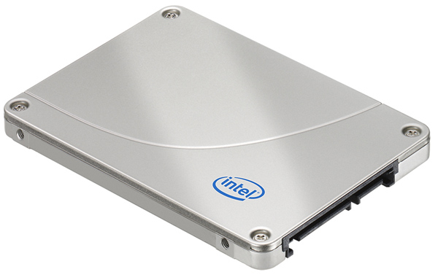

Flash is not
the solution
Notes:
Big vendors of EDW systems just offer switching spinning drives for flash drives!
EDW appliance vendors offer this at a premium cost – only makes sense if majority is flash
Really its about nanoseconds not milliseconds
Traditional EDW software is architected for lots of disk and relatively small amounts of CPU
Flash helps – bandaid on problem – buys a little time for the EDW if you can afford it – digital jolt

Slide 28
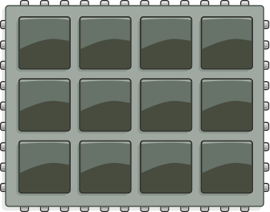

Analytics requires
CPU and RAM
In-memory Processing
Notes:
Processors and Ram are true measure of work that can be done – disks just fetch
Keep data in memory!!! Don’t swap, don’t wait on disk don’t pick through indexes then data, just access what is needed.
Economics of RAM have changed, much lower cost, large volumes readily available

Slide 29
Store and Analyze
Store
Analyze
fetch
Store
Store
Notes:
Classic database and DW says you store and analyse in same platform
The world is changing DW gets overloaded
Change the paradigm – separate storage and analysis – specialise
Low cost, flexible, safe, addressable storage = Hadoop or the existing EDW
High power in-memory for analytics
Draw data in on-demand, only copy, keep source integrity

Slide 30
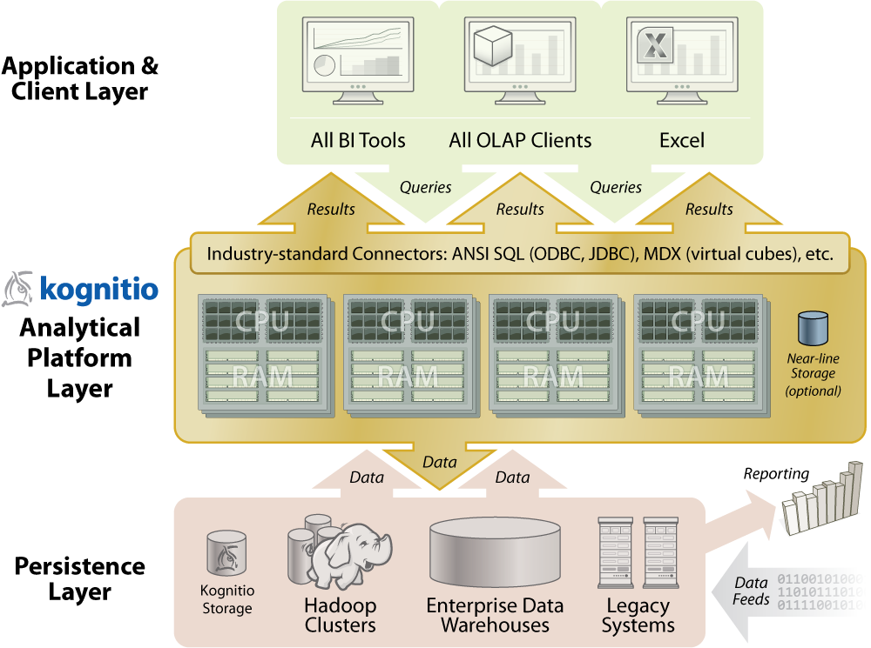
Notes:
Gold layer – bridge between persistent stores and the BI ecosystem
Protect investments in various systems and software
Keep the EDW in the game
Provide fast BI from data held in Hadoop
Give the users the analytical performance they want

Slide 31

BI governance
Centrally defined data models
Persist data in natural store
Fetch when needed, agile
Analytical power
Notes:
New phase of history – building phase after disruption caused by Hadoop and big data
Bring the Wild West back under control
connective tissue for enterprise – minimise disruption
In-memory data data models = flexibility and performance
Give users what they need – agility, ability to accommodate new data
Unifies data models and central control
with lots of performance and flexibility – keep IT and BI user happy
Gather back data – just as EDW had in the past

Slide 32
Accelerator for…
EDW – analytics stress relief
Hadoop – BI analytics
Notes:
Take the pressure off of the EDW – give it a further lease of life – triple by-pass
Give the new upstart a simple method of integration with the existing BI infrastructure

Slide 33
…discovery again
big
The new data pioneers
Notes:
Discovery is cool again – it needs CPU horsepower
made easier on the mountains of data stored in Hadoop
No reason why this does not feedback to the EDW
Hadoop for storage and coarse filter trawls, analytical platforms for fine grained detailed analysis

Slide 34
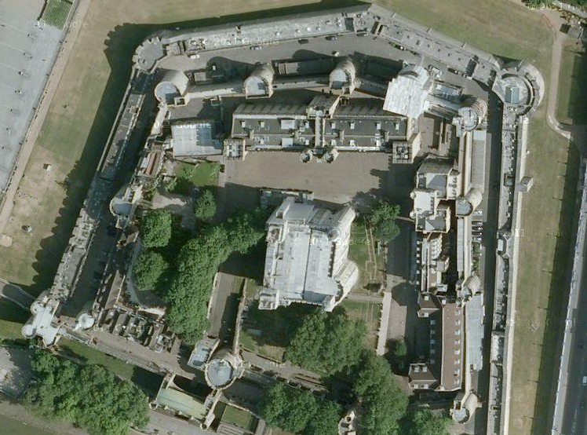
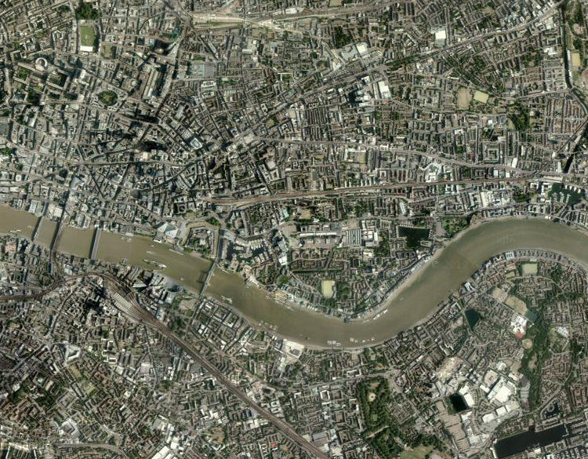
Notes:
The analogy of the Castle as EDW – well time has shown they are still around
Some have stood the test of time, some have crumbled
But all lost significance/relevance in a bustling city, are diminished
Future big data will dwarf the EDW – EDW will loose its central position
Will not disappear, still has good leasons to pass through (cycle of history)

Slide 35

So?
“It’s not EDW growing pains,
it’s the early onset of old age!”
Notes:
So is the EDW dead? – Note that prognosis is early
EDW will not be wiped just yet but boy is it sick
“How many people in room want to work on an EDW project?”
but it can be eloquently summed up as…

Slide 36




connect
contact
kognitio.com
Paul Groom
Chief Innovation Officer
paul.groom@kognitio.com
kognitio.tel
kognitio.com/blog
Michael Hiskey
VP, Marketing & Business Development
michael.hiskey@kognitio.com
twitter.com/kognitio
linkedin.com/companies/kognitio
tinyurl.com/kognitio
youtube.com/user/kognitiowx2
Notes:
Kognitio

